Slide 1

Progress Report II
Team 6 • Dream Builders
Sleep in Heavenly Peace (New River Valley)
Current materials through Mar 31, 2026
Dream Builders • Sleep in Heavenly Peace (NRV)

Slide 2
Agenda
01
Our Team
04
Project Documents
02
Current Goals / Progress
05
Next Steps
03
Current Challenges
06
Q&A

Slide 3





Our Team
Holden Crouse
PM
Asher Tilghman
Team Member
Andres Vasquez
Team Member
Weijin Hsu
Team Member
Luis Martinez
Team Member

Slide 4
Project goals and current status
Project focus
Partner with Sleep in Heavenly Peace (NRV) to support the spring bed-build effort.
Fundraise 40 twin bed-in-a-bag sets before the Apr 25 build and help the build run smoothly.
Use a structured project-management approach with clear milestones, roles, and sponsor communication.
50%
of bedding target documented
20 secured
20 remaining to reach 40 bed-in-a-bag sets
Milestone view
Status snapshot
Feb 5
Feb 9
Mar 31
Apr 25
bedding target reached
core PM deliverables
Sponsor confirmed
Kickoff meeting
Progress review
Primary bed build
20 / 40
8
20 sets remain
charter, scope, comms, schedule, risks
Current effort: Continue fundraising for bedding sets, collaborate with sponsor for bed deliveries, and run a successful bed build on April 25th
sponsor touchpoints
Apr
25
next major build date
10
Feb 1 to Mar 31
Apr 10 run-through

Slide 5
Current Challenges
Current pressure points
Simplified risk view
The biggest gap is still fundraising: 20 bed-in-a-bag sets remain before the Apr 25 target.
Some operating details are still unresolved, especially sponsor participation and delivery information.
The team must balance class deadlines with real project outreach, which compresses the timeline.
Impact →
Low
Medium
High
High
Med
Poor weather on build date
Lack of funding
Probability →
Operational risks already identified in the team risk analysis include weather, volunteers, bedding availability, and communication delays. The current meeting notes show that funding and delivery clarity remain the most immediate issues.
Low
Volunteer availability
Poor communication
Late delivery of materials

Slide 6
Mitigation Efforts
Weather prevents bed building outside
Track the weather for the bed build week and keep volunteers informed of change of build site.
Delay in materials
Try to order materials ahead of time with sufficient lead times for the bed build.
Unable to fundraise the 40 beds
Aim to complete fundraising a few weeks before the bed build, so we can figure out alternative solutions. If not on track, we will inform sponsor of the number short of our goal.

Slide 7
Contingency Plans
Weather make beds unable to be built outside
Sponsor has arranged for an indoor building site
Delays in bedding shipment
Cancel shipments and use money to pick up bedding in stores such as Target
Not enough volunteers
Reach out to friends and classmates to see who would be willing to volunteer
Unable to fundraise bed-in-a-bags
Inform sponsor far ahead of time if we are not on track to complete the goal, he might be able to use his donations to compensate

Slide 8
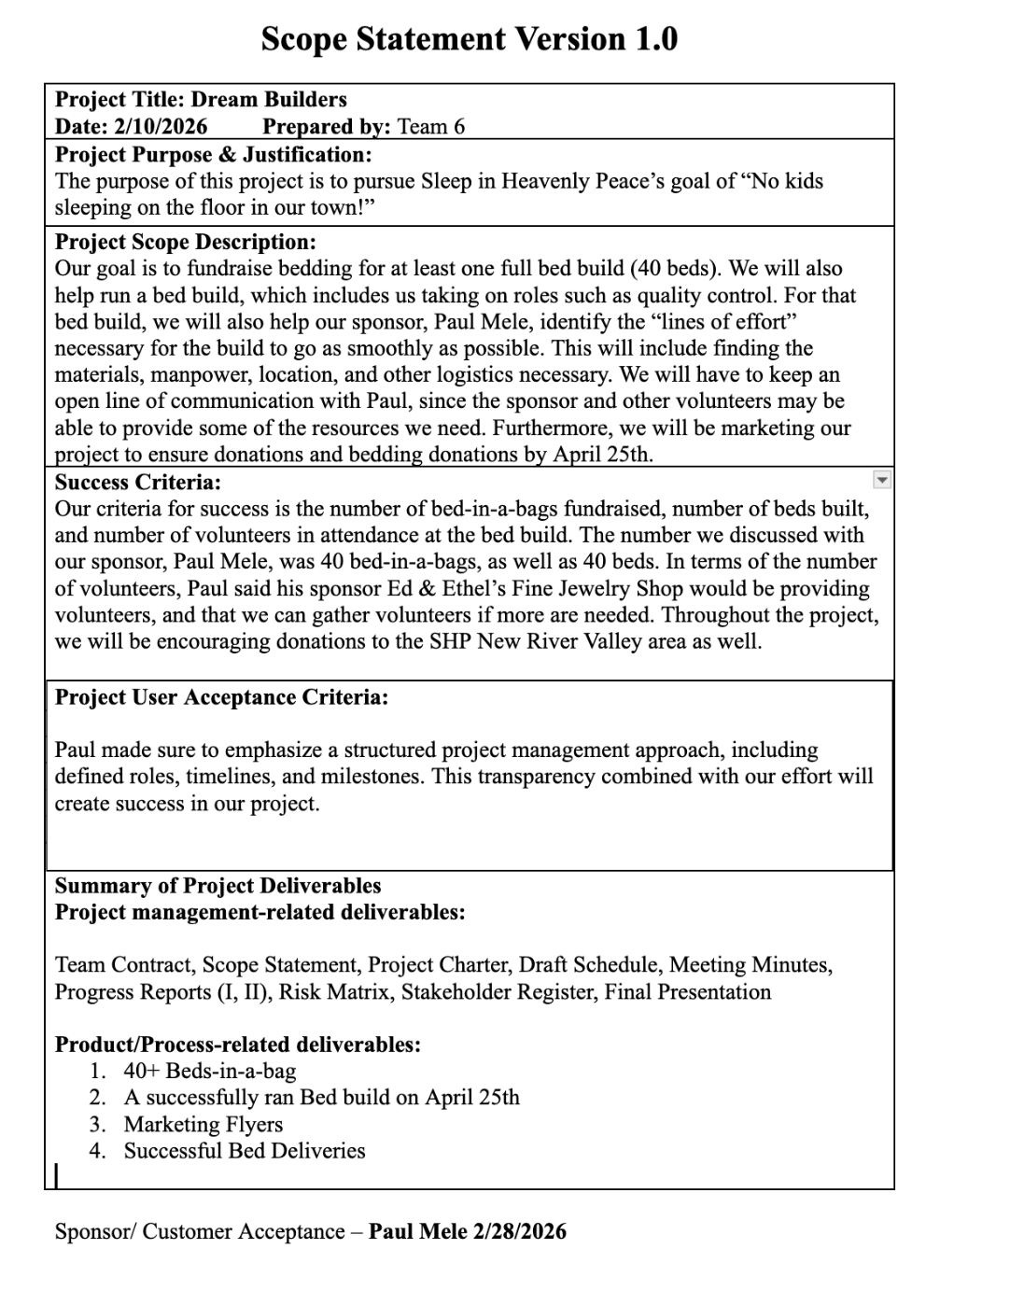
Scope Statement

Slide 9
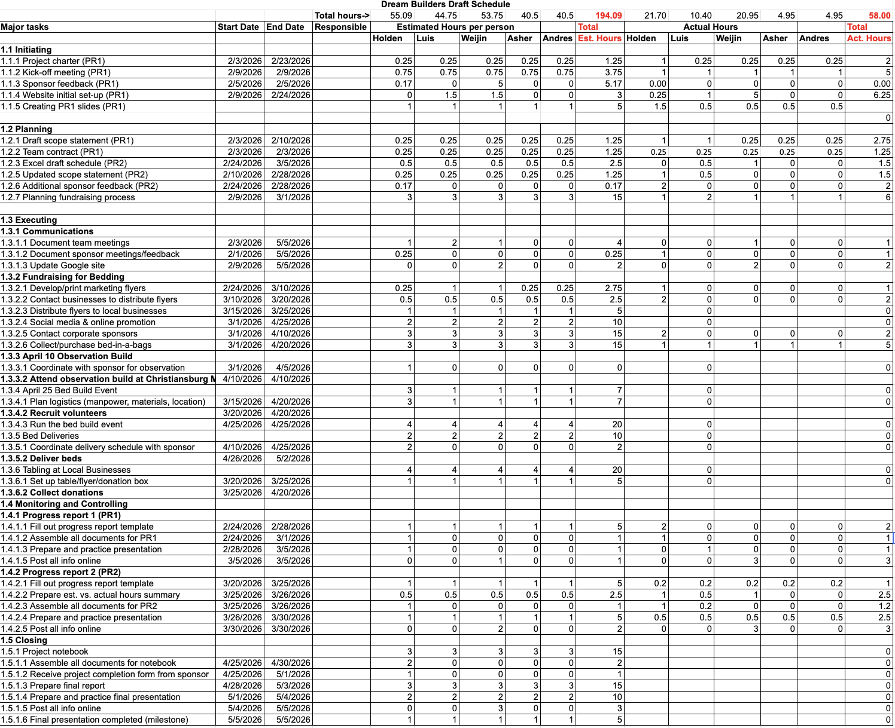
Draft Schedule

Slide 10
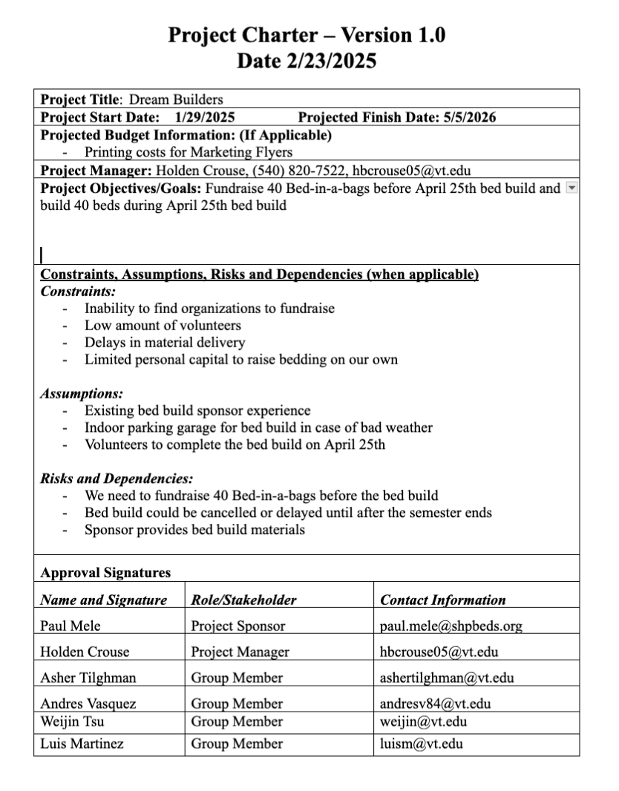
Project Charter

Slide 11
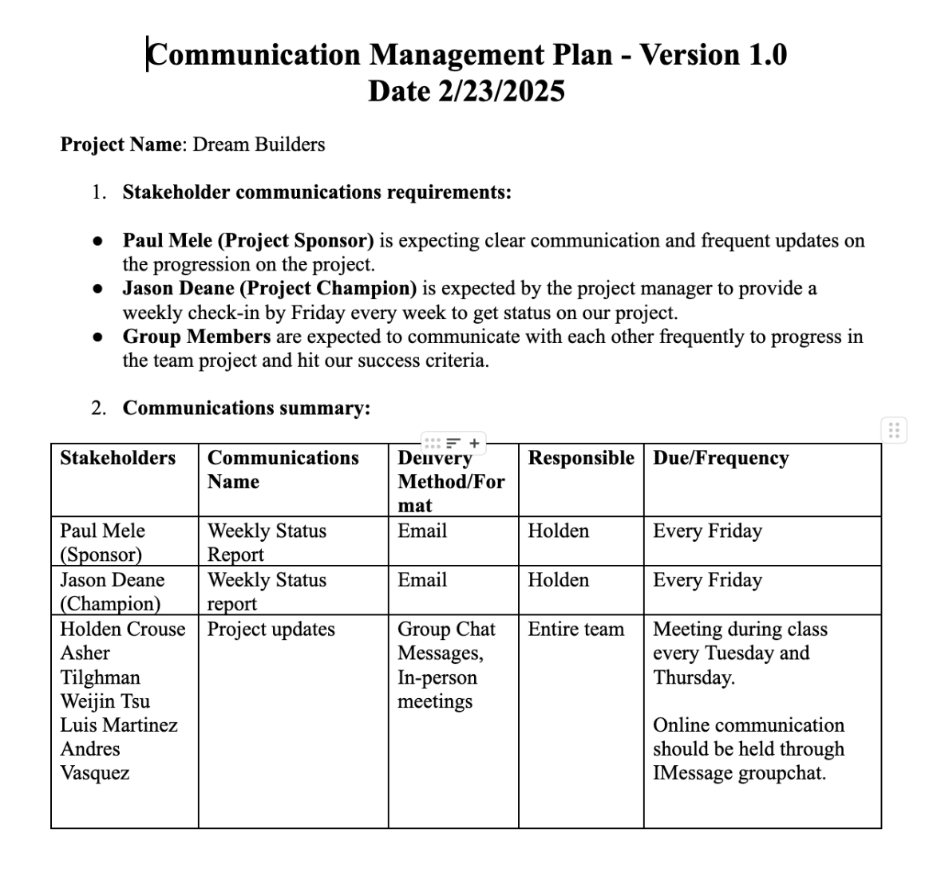
Communication Management Plan

Slide 12
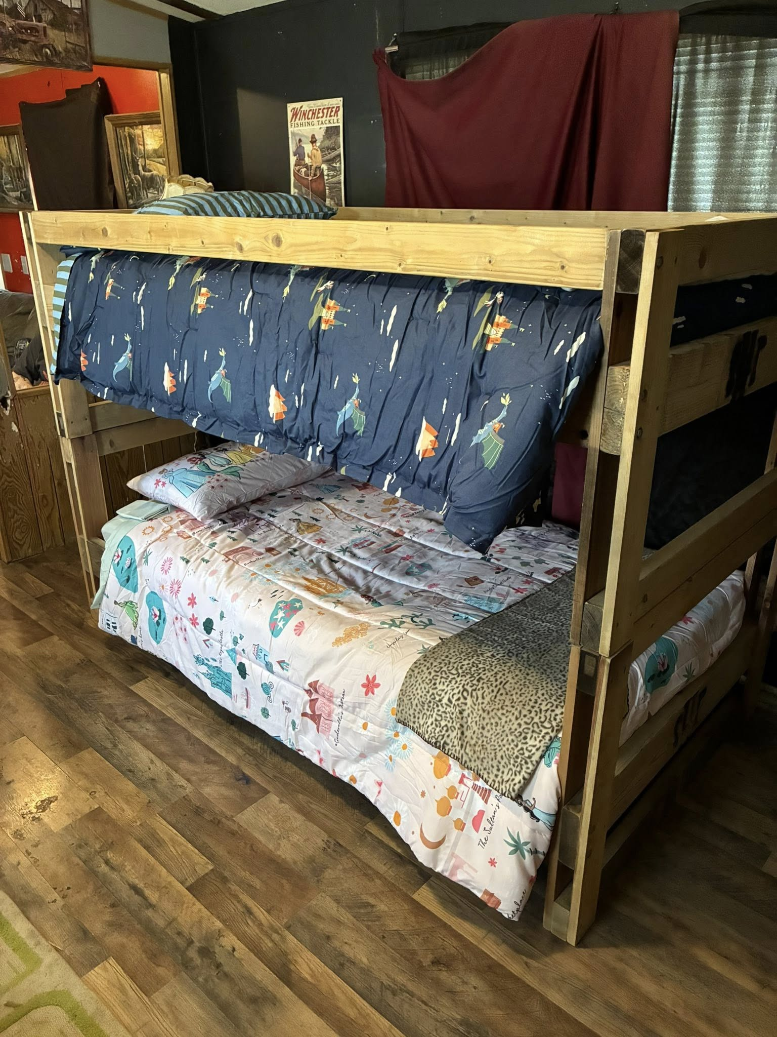
Next Steps
Complete fundraising
We need to finish fundraising the rest of the bedding before our bed build date, April 25th
Schedule bed deliveries
We are working with Mr. Mele to schedule a bed delivery hopefully for this week or next
Attending a bed build April 10th
We are going to help prepare for the bed build our group will be helping with later that month
Our end goal, the April 25th bed build
On April 25th, we will be delivering our fundraised bed-in-a-bags and assisting in a bed build

Slide 13
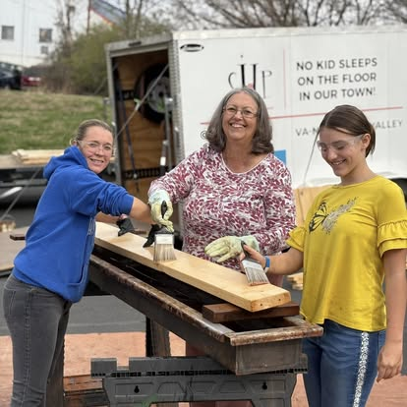
How we plan to raise 20 more beds
Local Community Donations
Our group has began going to local businesses, churches, and organizations in the Blacksburg-Christiansburg area.
Business Sponsorship
Working with suitable sponsors for SHP such as Lowes, Mattress Warehouse, Grand Home Furnishings, etc
Setting up a Percentage Night
Using a percentage night with a local, non-chain restaurant to gain donations to raise the last sets of beds-in-a-bag

Slide 14
Questions?

